Slide 2
Types of testing
Functional testing: Testing the code
Non-functional testing: lagging, scalability( can 2 million users use the software at the same time?)

Slide 3
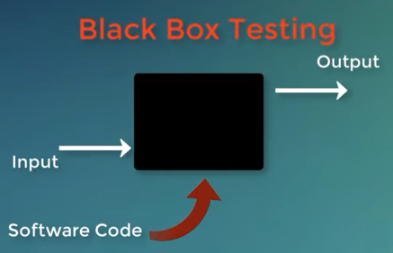
Testing techniques
Black box testing :
White box testing: check actual code

Slide 4
Level of testing
Unit testing (class testing )
Integration testing (combine different classes)
System testing (how it interact with other software)

Slide 5
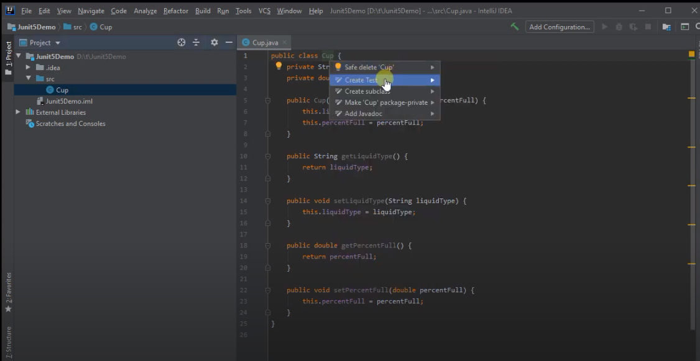
How to create test class
Reference link :https://www.youtube.com/watch?v=o5pE7L2tVV8

Slide 6
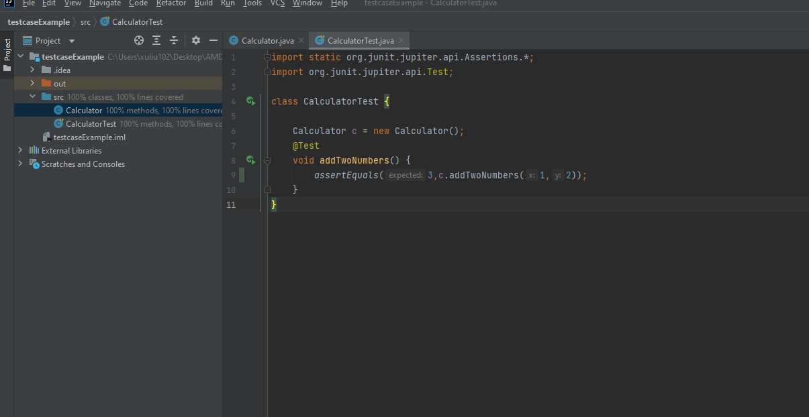
Create testcase

